Slide 1


Blockchain Based Crowdfunding

Slide 2
Group7(ABT)
Abdullah Alanazi
Aedah Alrehaili
Ayat Bu-Suhail
Bayan Alserhani
Thuraya Alrwaili
Instructor: Jonathan
Teaching Assistant: Xiaomei and Adam

Slide 3
TABLE OF CONTENTS
01
05
02
03
06
04
Important Terminology
Why smart contracts?
Project overview
Main problems
Project Goals
07
Why we pick this idea?
Demo

Slide 4
Important Terminology :
Blockchain: is a list of continuously growing records called blocks. Each Block is linked to each other and they were secured using cryptography.
Crowdfunding: is an online money-raising strategy that began as a way for the public to donate small amounts of money to help creative people finance their projects.
Ethereum: is an open-source, public, blockchain based distributed platform and operating to featuring smart contract functionality.
smart contract: is a self-executing contract with the terms of the agreement between buyer and seller being directly written into lines of code.

Slide 5
Project overview
A crowdfunding smart contract where a project gets funded by raising amounts of Ether on the Ethereum blockchain. The project gets its value due to blockchain technology that helps verifying data from seekers and funders, eliminating dependence on third parties and speeding up the submission and disbursement of funds.

Slide 6
Main problems
Issue: slow cross-border payment
Solution: introduce a faster and transparent payment gateway
Issue: accountability issues in traditional contracts
Solution: smart contract offers transparency, and faster settlement

Slide 7
Why we pick this idea?
The need of a decentralized crowdfund now days since we are in the evolution of the web3.
More secure.
Fast to transfer the money to the client
Encourage the investor to participate in the world’s future fund to create their idea throw this fund.
Easy way to share ideas in blockchain area.
Good investment to get ideas and raise money.

Slide 8
Why we choose the smart contracts?
Smart contract | Traditional contract
Fast and efficient | Time-consuming
No need for the authority of a third party | Requires a third party for authenticity
Cost-effective | Expensive
Virtual presence (digital signature) | Physical presence (wet signature)
Immutable | Mutable by anyone
Automatic payment | Manual payment

Slide 9
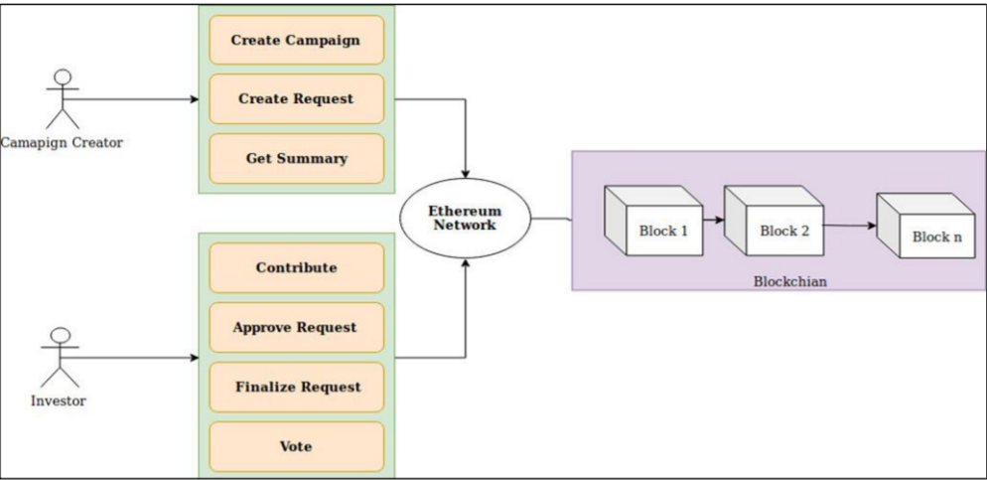
Working Model

Slide 10
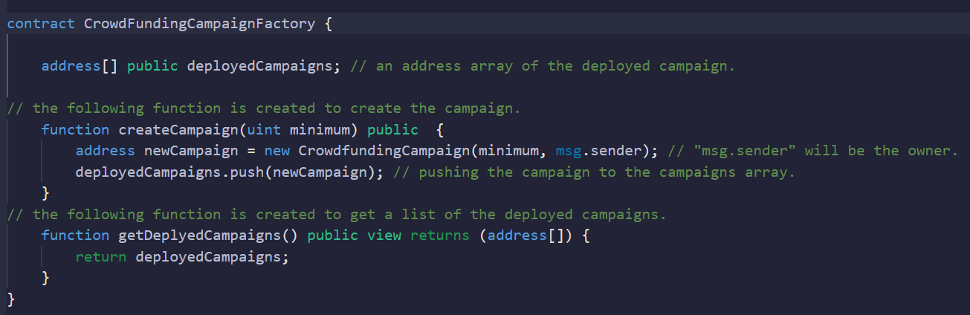
Project Goals:
1. Create the main contract which is the crowdfunding Campaign Factory

Slide 11
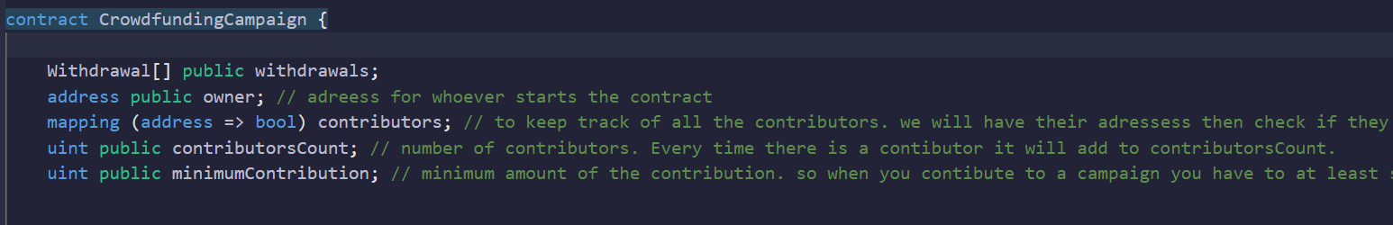
Project Goals:
2. create crowdfunding contract that allows anyone to get donations for calls.

Slide 12
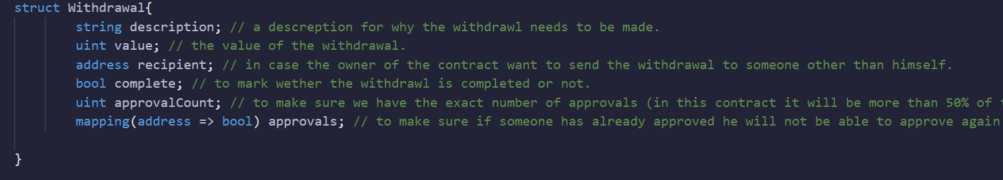
Project Goals:
3. Create a struct withdrawal that requests the raised amount and draws it

Slide 13
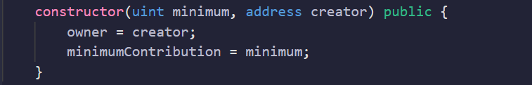
Project Goals:
4. Create constructor which has the minimum amount of the contribution and the address of the owner.

Slide 14
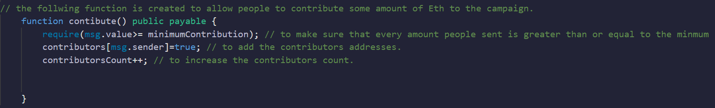
Project Goals:
5. Create contribute function which checks if the minimum contribution has been met.

Slide 15
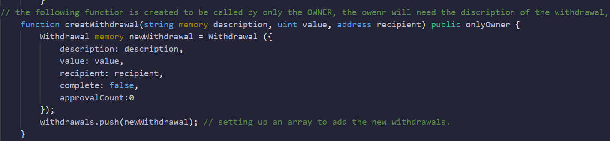
Project Goals:
6. create withdrawal function which allows users to create requests.

Slide 16
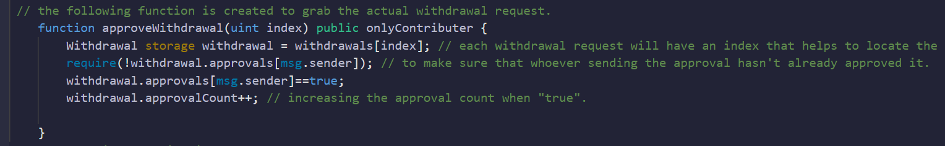
Project Goals:
7. create approval function that will grab the actual withdrawal request.

Slide 17
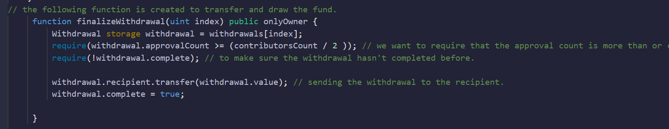
Project Goals:
8. Finalizing function that transfers the funds and draws it.

Slide 18
Demo

Slide 19
Conclusion
Blockchain in crowdfunding is a relatively new concept to the community. We have taken that into consideration and designed this project as simples as possible, this is not the end for improvement and evolution. We wish in the future to provide an even easier and safer way for all ideas to get life through our crowdfunding application.

Slide 20
Thank You
Any Question ?

Slide 21
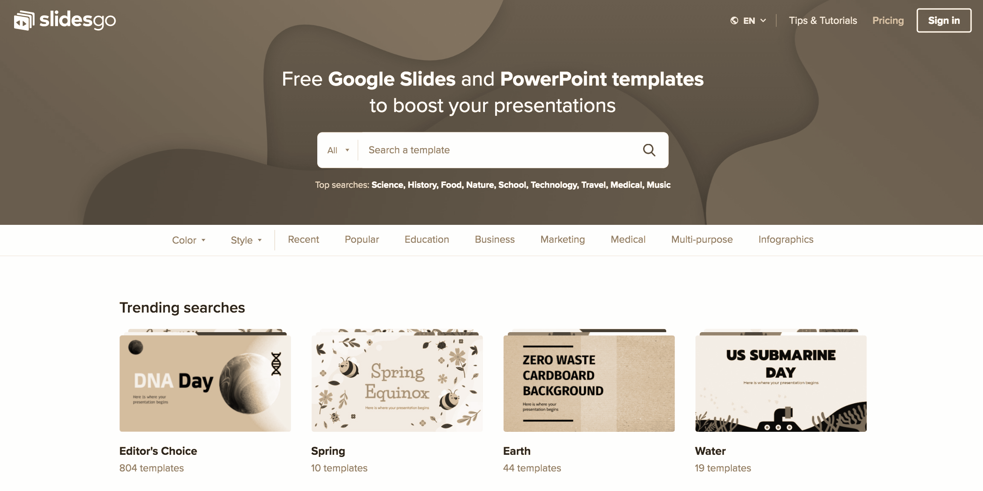


Resources
https://journals.indexcopernicus.com/api/file/viewByFileId/594400.pdf
https://github.com/akcgjc007/kick_U
https://www.researchgate.net/publication/342742097_Smart_Contract_and_Blockchain_for_Crowdfunding_Platform

